Slide 1
NASA Turbofan Jet Engine Predictive Maintenance
By: Jay Nakum

Slide 2
Abstract
Maintenance of equipment is a critical activity for any business involving machines.
Predictive maintenance is the method of scheduling maintenance based on the prediction about the failure time of any equipment.
RUL: Remaining Useful Life
RUL is considered the most complex task in predictive maintenance, at the same time the most beneficial one.
In this work the goal is to predict the RUL of each engine in the test dataset.

Slide 3
Introduction
A turbofan engine is the most modern variation of the basic gas turbine engine. Most modern airliners use turbofan engines because of their high thrust and good fuel efficiency.
About 60% of the total faults of the aircraft are related to the turbofan engine [1].
Basic overview of the steps included in maintenance.
Defining the work scope
Cleaning and inspection
Disassembly
Repair and Replace
Assembling and Testing

Slide 4
Introduction
Small jet engines tend to cost in the $200k-$300k range per engine. And eventual overhaul cost for modern turbofans could be between $1m-$3m [2].
The RUL prediction of the turbofan engine will provide an important basis for predictive maintenance and pre maintenance.

Slide 5
Related Work

Slide 6
Emmanuel Ramasso and Abhinav Saxena, 2014 [3]
Performance Benchmarking and Analysis of Prognostic Methods for CMAPSS Datasets.
The data were used for the first time as part of a prognostic challenge at the PHM'08 conference. Thereafter, another four datasets with varying degrees of complexity were released (FD001-FD004).
To draw conclusions from these efforts, Ramasso and Saxena conducted a first review, in which they compared and classified several aspects of existing solutions identified in forty unique studies.

Slide 7
Vimala Mathew, Tom Toby, Vikram Singh, B Maheswara Rao, M Goutham Kumar, December 2017 [4]
Information Technology Group, National Institute of Electronics and Information Technology, Calicut, Kerala, India
Machine Learning based approach with 10 algorithms.

Slide 8
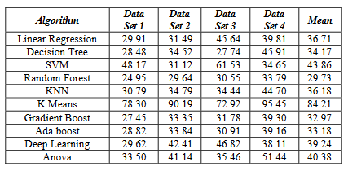
Their Results

Slide 9
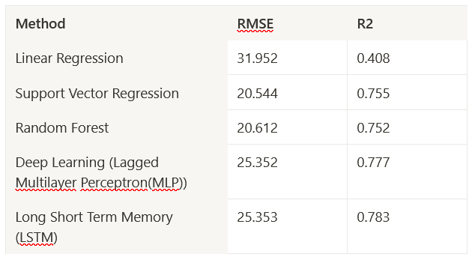
Koen Peters Towards Datascience, September 2020 [5]
Published an 8 article series with a detailed explanation of all the following approaches.

Slide 10
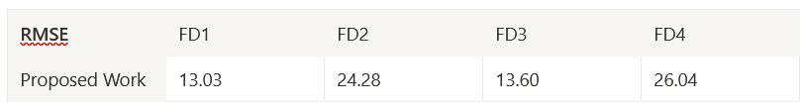
Benjamin Maschler, Hannes Vietz, Nasser Jazdi, Michael Weyrich, September 2020 [6]
Institute of Industrial Automation and Software Engineering, University of Stuttgart, Stuttgart, Germany
Deep Learning based approach with Elastic Weight Consolidation. It is a technique used in overcoming catastrophic forgetting between successive tasks trained on a neural network.

Slide 11
Dataset Description
Commercial Modular Aero-Propulsion System Simulation (C-MAPSS) [7].
Records several sensor channels to characterize fault evolution. The data set was provided by the Prognostics CoE at NASA Ames.
Realistic characteristics:
multi dimensional sensor measurements
high level noise
masked fault effects through different operating conditions
The data set used in this work is the Kaggle version of the public data set for asset degradation modeling from NASA.

Slide 12
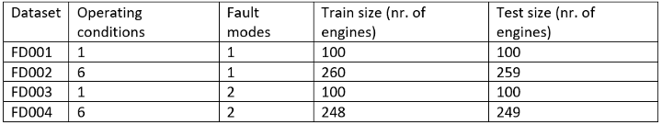
Dataset Description
It includes Run-to-Failure simulated data from turbo fan jet engines.
Four different sets were simulated under different combinations of operational conditions and fault modes.

Slide 13
Dataset Description
Datasets include simulations of multiple turbofan engines over time, each row contains the following information:
1. Engine unit number
2. Cycle Time
3. Three operational settings
4. 21 sensor readings

Slide 14
Proposed Work
The objective of the competition is to predict the number of remaining operational cycles before failure in the test set, i.e., the number of operational cycles after the last cycle that the engine will continue to operate.
Classical machine learning tasks like: Data Exploration, Data Cleaning, Feature Engineering, Model Building and Model Testing.
Try out different machine learning algorithms that’s best fit for the above case.

Slide 15
Conclusion
Developing a functioning system that implements the work done that can accurately predict the RUL of engines would be greatly helpful.
Future work.

Slide 16
References
[1] Jing Wei, Peixin Bai, DaTong Qin, Teik C. Lim, PanWu Yang, Hong Zhang. Study on Vibration Characteristics of Fan Shaft of Geared Turbofan Engine With Sudden Imbalance Caused by Blade Off.
[2] What is Jet Engine Maintenance?, AV Buyer
[3] Ramasso, Emmanuel & Saxena, Abhinav. (2014). Performance Benchmarking and Analysis of Prognostic Methods for CMAPSS Datasets. International Journal of Prognostics and Health Management. 5. 1-15. 10.36001/ijphm.2014.v5i2.2236.
[4] V. Mathew, T. Toby, V. Singh, B. M. Rao and M. G. Kumar, "Prediction of Remaining Useful Lifetime (RUL) of turbofan engine using machine learning," 2017 IEEE International Conference on Circuits and Systems (ICCS), 2017, pp. 306-311, doi: 10.1109/ICCS1.2017.8326010.
[5] Exploring NASA’s turbofan dataset Predictive maintenance of turbofan engines, Towards Datascience
[6] B. Maschler, H. Vietz, N. Jazdi and M. Weyrich, "Continual Learning of Fault Prediction for Turbofan Engines using Deep Learning with Elastic Weight Consolidation," 2020 25th IEEE International Conference on Emerging Technologies and Factory Automation (ETFA), 2020, pp. 959-966, doi: 10.1109/ETFA46521.2020.9211903.
[7] https://software.nasa.gov/software/LEW-18315-2

Slide 17

jaynakum.github.io

